Slide 1

Click anywhere to get started…

Slide 2
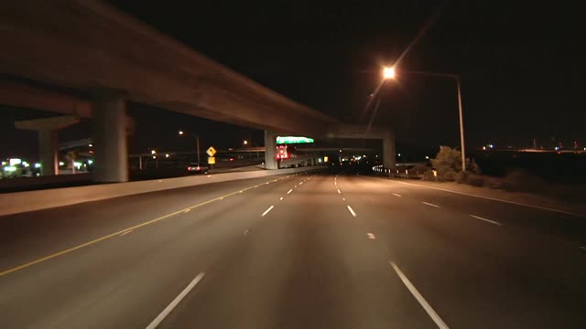


Darkness Descends on the Road to Work
Notes:
Darkness Descends on the Road to Work

Slide 3
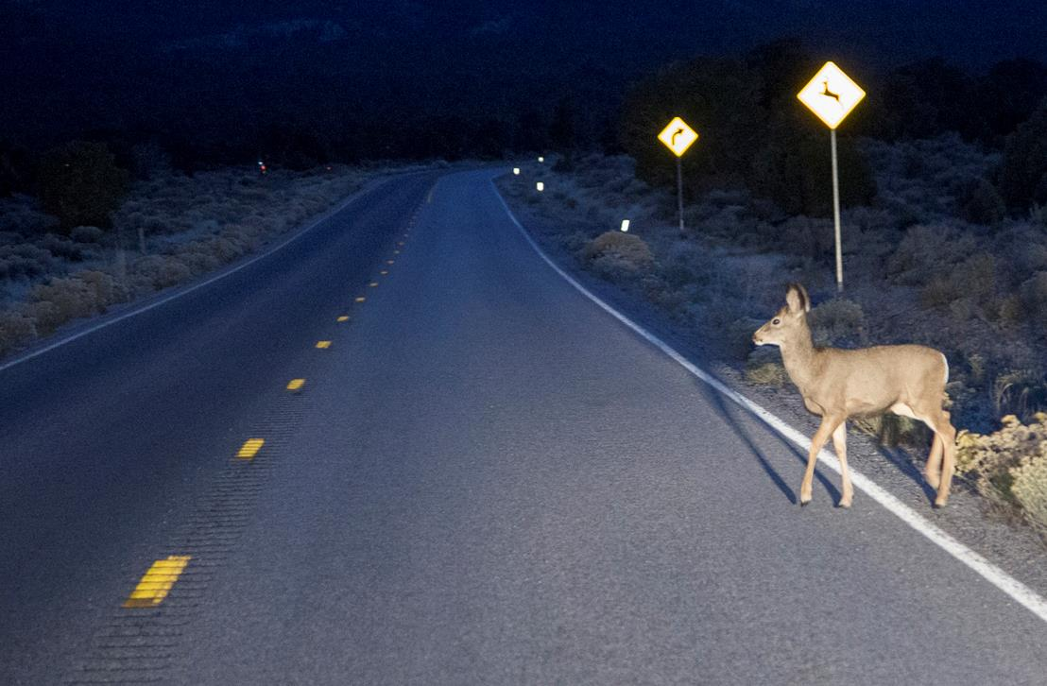
What’s at Stake?
Drivers must appreciate that night time driving has unique challenges, which include sunlight not being available and other objects or animals being hidden because of it.
This means you must take precautions for night time driving.
Notes:
What’s at Stake?
Drivers must appreciate that night time driving has unique challenges, which include sunlight not being available and other objects or animals being hidden because of it. This means you must take precautions for night time driving.

Slide 4
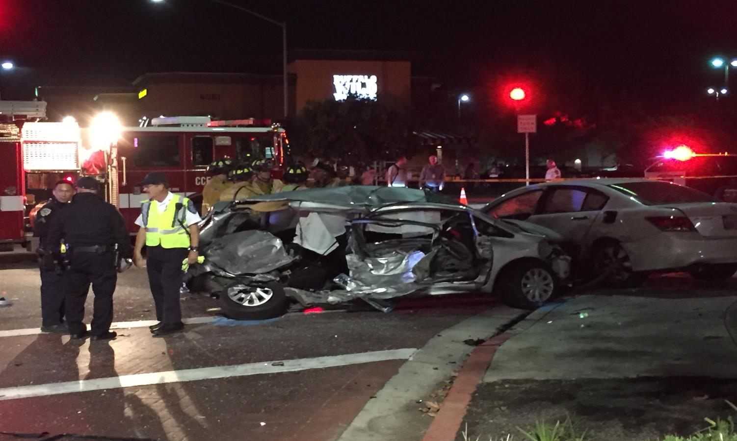
What’s the Danger?
Night time driving is only one quarter of the time people spend on the road, yet more than half the vehicle fatalities occur after dark.
People are three times more likely to be in a fatal crash at night than during the day.
Most vehicle/animal crashes occur at night.
Notes:
What’s the Danger?
Night time driving is only one quarter of the time people spend on the road, yet more than half the vehicle fatalities occur after dark.
It has been reported by the National Highway Traffic Safety Administration that people are three times more likely to be in a fatal crash at night than during the day and most vehicle/animal crashes occur at night.

Slide 5
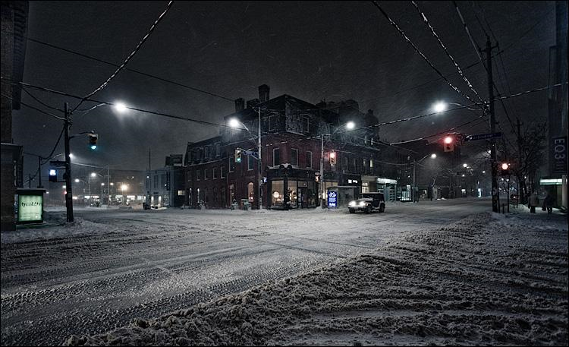
How to Protect Yourself
Allow more time to get to work
  Darkness, frost, snow, or ice
  Frost, oil, snow, and ice on roads makes roads slippery
Check your driving lights
  Keep them clean and clear
Notes:
How to Protect Yourself
The following is a good review of things you can do and common-sense practices to make night time driving safer.
Allow more time to get to work.
Besides the darkness, there may be frost, snow, or ice to remove from the windshield.
Frost on the roads, especially when combined with the oil which seeped out of the blacktop in the hot weather, makes roads slippery. As does snow and ice.
Check your driving lights regularly and keep them clean and clear of obstructions.

Slide 6
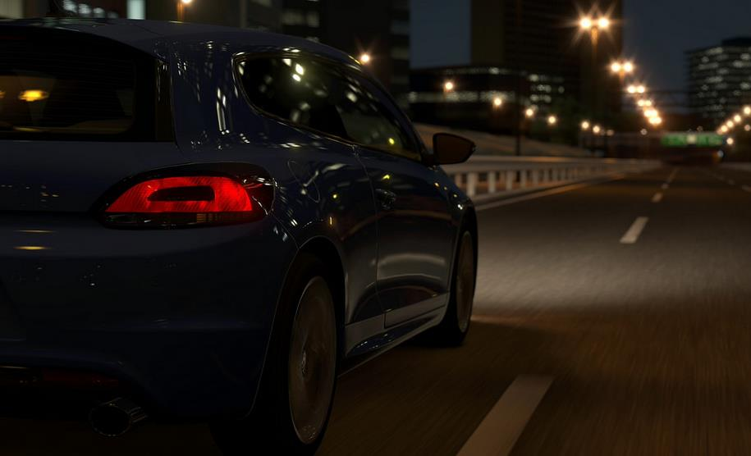
How to Protect Yourself
Turn headlights on as soon as the sky dims.
Use low beams when following another vehicle or when vehicle approaches.
  Blinding others endangers you and them.
Look beyond your headlights
  Use streetlights and other vehicle lights to help you see.
Leave extra space around your vehicle to allow for more reaction time.
Notes:
Turn your headlights on as soon as the sky dims.
Use your low beams when you are following another vehicle or when a vehicle approaches you.
Blinding others with your high beams endangers you and them.
Look beyond your headlights.
Use streetlights and the lights of vehicles in front of you to see down the road.
Leave extra space around your vehicle to give yourself and others more reaction time.

Slide 7
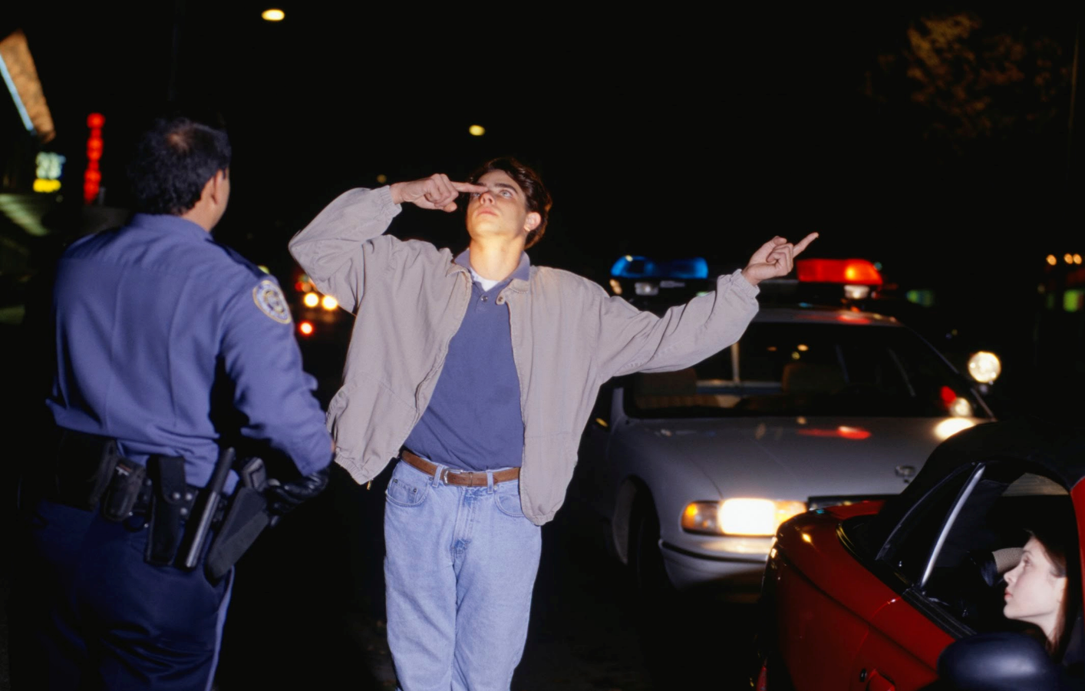
How to Protect Yourself
1 out of 13 drivers are drunk in early morning hours
  Be alert and give other drivers space
  Pull over and call police if you think a driver is under the influence – if safe
Pull off the road as far as possible
  Warn other drivers with hazard lights, headlights, interior lights, and flares
  Stay in car until help arrives
Notes:
Impaired drivers are a danger to everyone on the road.
Statistics suggest that one out of 13 drivers drive drunk in the early morning.
Be alert and give other drivers plenty of space to maneuver.
If safe to do so, pull over and call the police if you think another driver is driving under the influence.
If you have vehicle trouble, pull as far off the road as you can.
Warn other drivers with your hazard lights, headlights, interior lights, and flares if you have them.
Stay in your car until help arrives.

Slide 8
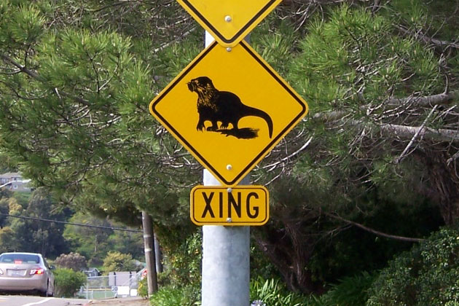
How to Protect Yourself
Collisions with wildlife can be fatal – more active at dawn/dusk
  Watch for signs, slow down, be alert
  Honk don’t flash lights - high beams may cause animal to freeze
If animal runs out in front of vehicle:
  Brake and slow down if safe
  Don’t swerve – it can send your vehicle out of control
Notes:
Collisions with wildlife can be fatal and animals are more active in the early morning and early evening.
Observe warnings of animal crossing, slow down, and be alert.
Honk instead of flashing your lights if you encounter an animal because high beams may cause the animal to freeze.
If an animal runs out in front of your vehicle:
Brake and slow down if it’s safe to do so – though it might not be the safest option.
Try not to swerve because swerving might send your vehicle out of control and the confused animal may jump in front of your vehicle anyway.

Slide 9
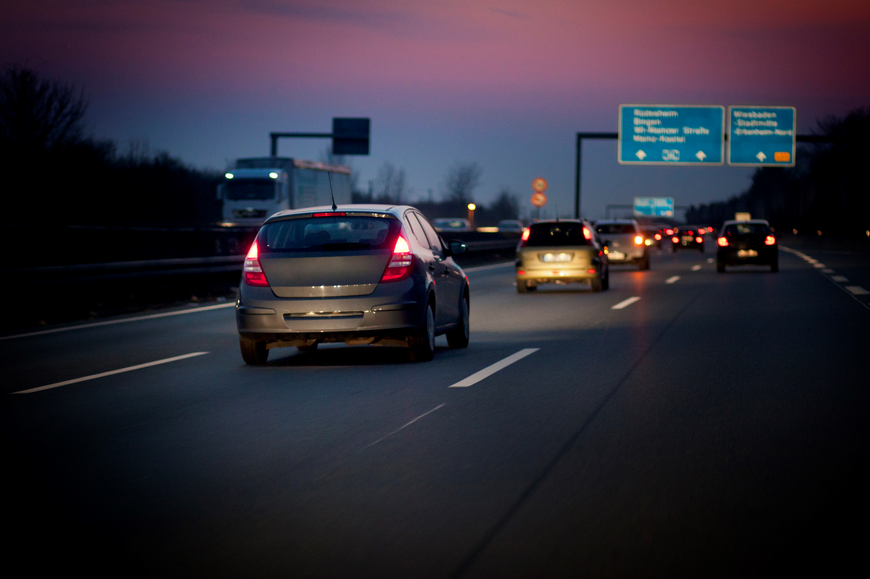
Final Word
Adjust your driving to accommodate traveling at night. Leave yourself more time to travel, and be alert to dangers on the road.
Notes:
Final Word
Adjust your driving to accommodate traveling at night. Leave yourself more time to travel, and be alert to dangers on the road.

