Slide 1

Click anywhere to get started…

Slide 2
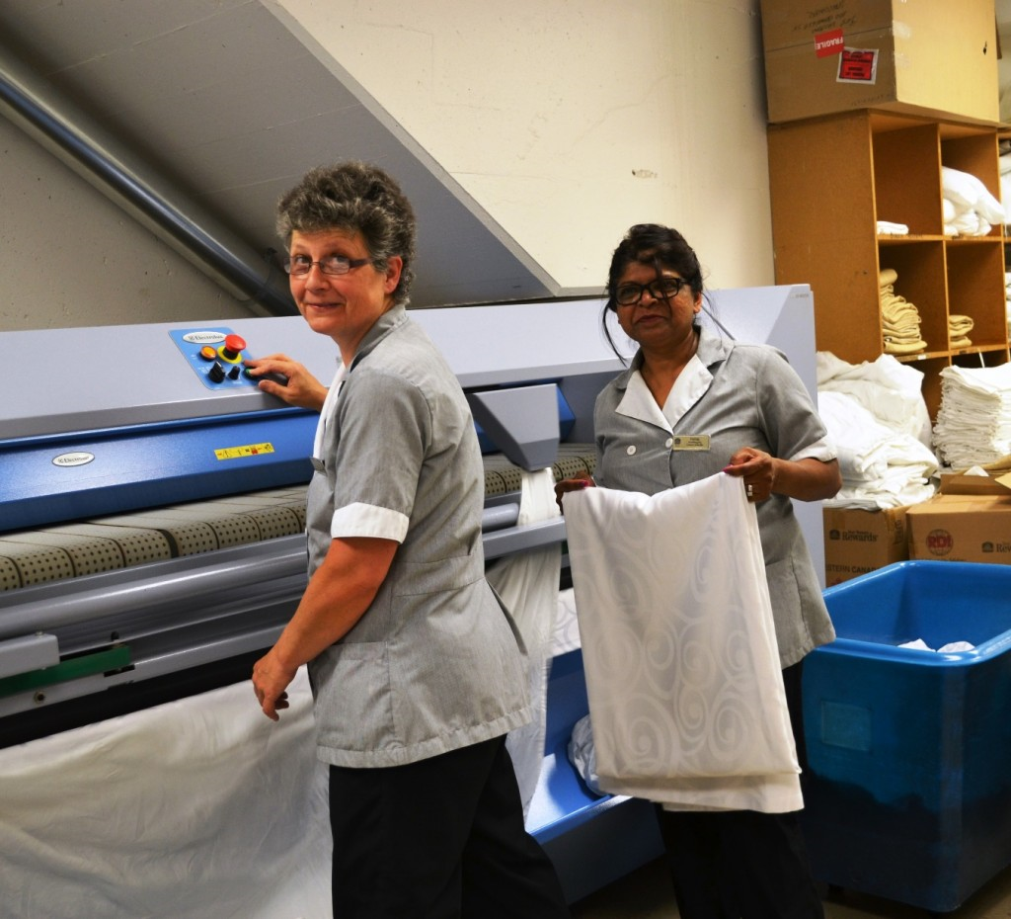


Healthcare - Keeping Housekeeping Staff Safe
Notes:
Healthcare - Keeping Housekeeping Staff Safe

Slide 3
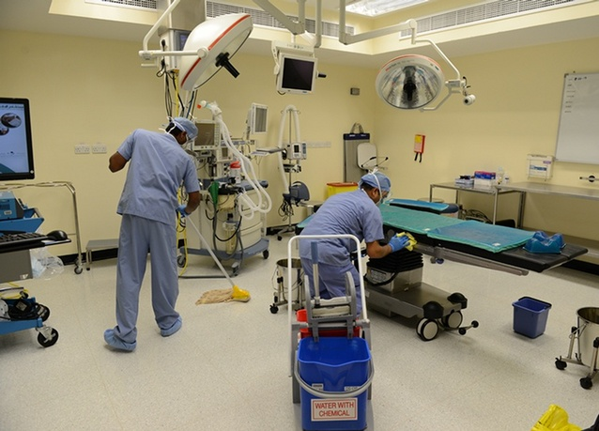
What’s at Stake?
Housekeeping staff keep the healthcare environment safe.
Exposed to body fluids, hazardous materials, discarded sharps, or needles.
Puts them at risk for illnesses.
Without proper care, they may increase the risk of patients and colleagues developing illnesses.
Notes:
What’s at Stake?
Housekeeping staff working in healthcare keep the environment safe for patients, staff, and visitors. They work around patients and in areas where clinical care has been given. In these environments, there are often body fluids or hazardous materials such as chemicals, discarded sharps, or needles.
Housekeeping staff are at risk of becoming ill or injured and without proper care, they may also increase the risk of patients and colleagues developing illnesses.

Slide 4
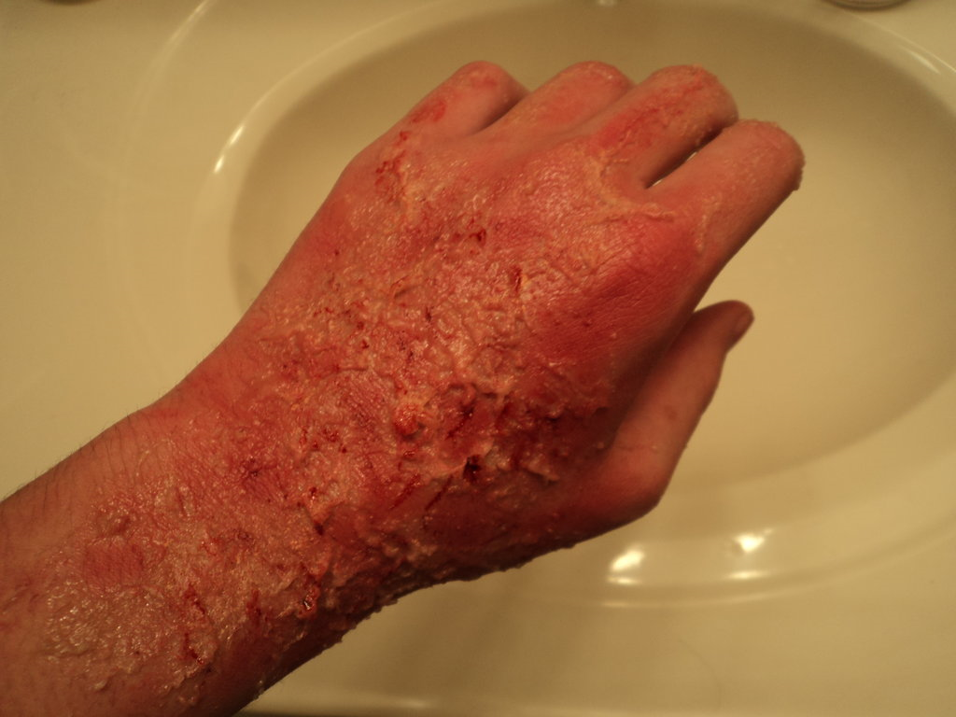
What’s the Danger?
Contaminated crockery, clothing, waste bins
Close proximity to patients
Sensitivity/burns from cleaning products and chemicals
Latex allergy
Slip hazards from wet floors
Overreaching and falling
Notes:
What’s the Danger?
Housekeeping staff are at risk of handling items contaminated with infectious matter, such as crockery, clothing, and waste bins. They are often in close proximity to patients who may be coughing, or sneezing, and infectious matter can be inhaled, ingested or spread onto skin or clothing.
Housekeepers also use various cleaning products that can cause sensitivity or chemical burns. The main form of defense is to wear gloves but this can lead to latex allergy…
Cleaning floors increases the risk of housekeepers, and other people, slipping on the floor. To get to awkward places, housekeepers may try to overreach or stand on furniture to get to these out of reach places, increasing their risk of falling.

Slide 5
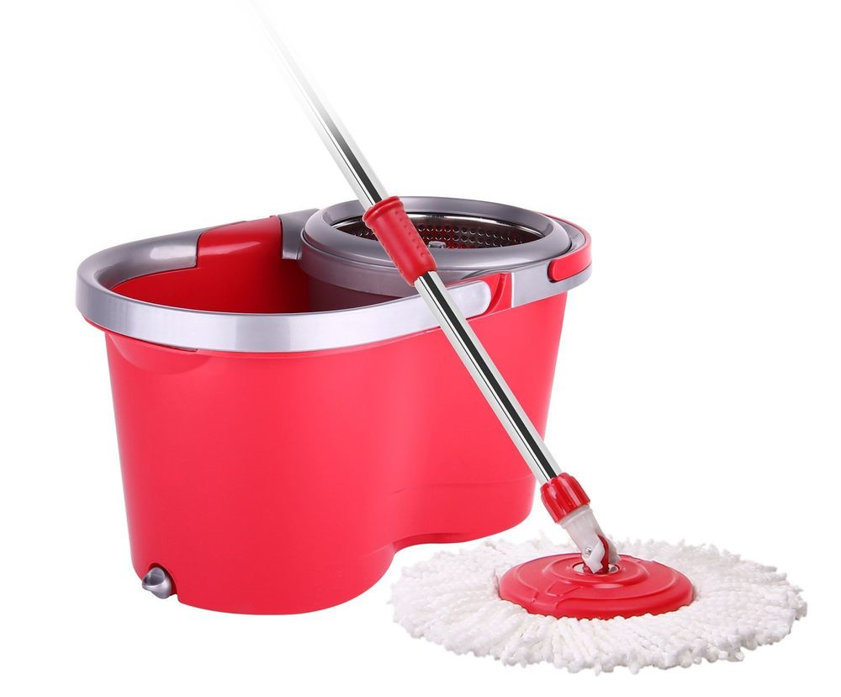
How to Protect Yourself
Know what you are doing
  Check policies and risks daily for policies and risks
Stay on your feet
  Stay off wet floors and put out warning signs
  Do one side at a time
  Watch for wet floor signs during your day
  Use caution when filling containers
  Clean up spills
Notes:
How to Protect Yourself
There are 6 easy ways to keep yourself safe as a housekeeper:
1. Know what you are doing
Have your schedule for the day.
Check any particular policies for the particular area you are working.
Check if there are any specific risks.
2. Stay on your feet
If you are cleaning a floor stay off the wet areas:
put hazard boards out to warn others;
leave them there until floor completely dry;
do one side of a corridor first, so people have a dry side to walk on, where possible;
advise people not to rush and to use handrail when walking on wet stairs.
Take note of any wet floor signs as you go about your work.
Avoid excessive water splashing when filling buckets, water jugs etc.
Clear up any spills immediately and put ‘Wet Floor’ signs out.

Slide 6
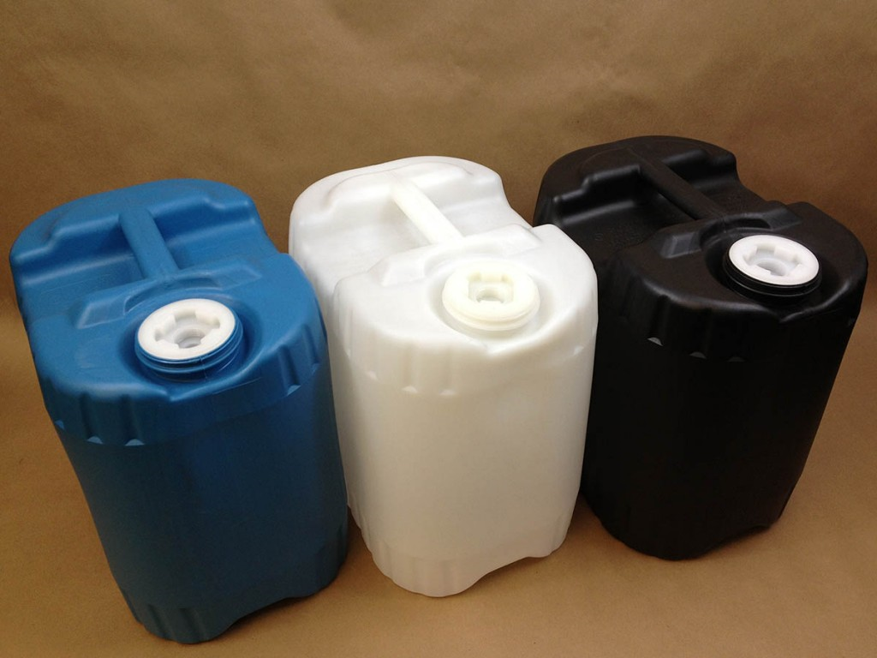
How to Protect Yourself
Be aware of chemicals
Check the labels
Use correct cleaning agents
Check dates – bleach solutions made up every 24 hrs
Don’t mix different detergents/cleaners
Wear gloves
First aid for:
  Chemical splash in or near eyes
  Breathing problems, nauseous, vomiting
Notes:
3. Be aware of chemicals
Know what you are using and check label on container.
Use only the correct cleaning agent for the correct process.
Check if it is in date; fresh solutions of diluted household bleach need to be made up every 24 hours.
Never mix different detergents either in containers or on cloth.
Wear gloves if indicated or if you have broken skin or skin sensitivity.
Use non-latex gloves if you are sensitive to latex.
Get first aid immediately if…
a chemical splashes in or near your eyes;
you start having breathing difficulties;
you feel nauseous or vomit while using a particular detergent.

Slide 7
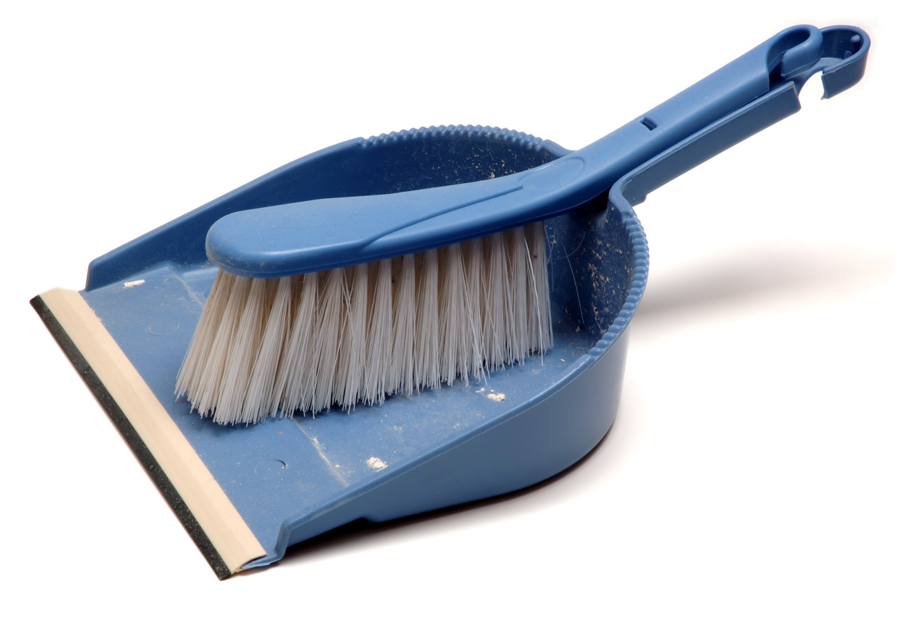
How to Protect Yourself
Don’t touch
Wear PPE
Use mops, dustpan/brush, tongs
Clean equipment
Label substance and location of contamination
Remove obvious contaminants before disinfection grossly contaminated equipment
Discard any protective covers after use
Notes:
4. Don’t touch
Wear appropriate PPE.
Use tools such as mops, dustpan and brush, and tongs, to avoid touching contaminated equipment, materials, or broken glass.
Equipment and work surfaces need cleaning after contamination.
The substance and location of contamination should be clearly labeled.
Grossly contaminated equipment and surfaces need cleaning with soapy water to remove obvious contaminants before disinfecting.
Protective coverings such as plastic or aluminum foil should be discarded as soon as the equipment is finished with.

Slide 8
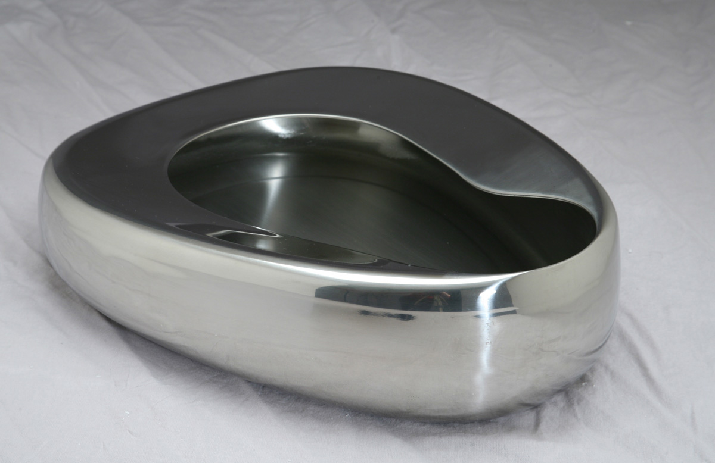
How to Protect Yourself
4. Don’t Touch cont.…
Check and clean reusable containers on a schedule – decontaminate immediately
Never pick up broken glass with bare hands
Use the laundry
Bag all laundry and never rinse it in care setting
Bagged laundry only in care environment
Use melt away bags with marked outer bags
Notes:
4. Don’t Touch Cont.
Reusable containers should be checked and cleaned on a schedule – decontaminate immediately if contamination occurs.
Broken glass should never be picked up with bare hands – there is a risk of cutting yourself and the glass could be contaminated.
5. Use the laundry
Bag all laundry items and move them to the laundry facility.
Laundry should not be rinsed in the care setting, or carried through the care environment, unless bagged.
Contaminated laundry should be in melt away bags and suitably marked outer bags to alert others.

Slide 9
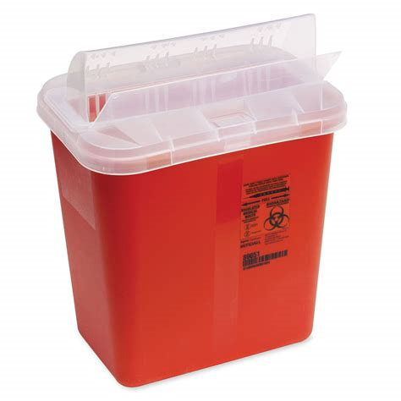
How to Protect Yourself
Be sharp
Check and remove discarded sharps before sending to laundry
Only dispose of sharps if you have received training
Dispose of sharps in correct containers
Report improperly discarded sharps
Complete injury report if punctured/grazed by a sharp
Notes:
Be sharp
Discarded, used sharps are a risk for all healthcare workers.
Carefully check for and remove any discarded sharps before sending items to the laundry.
Only dispose of sharps if you have received training.
Carefully dispose of any sharps in an appropriate container…
Do not push the sharp, hands, or fingers into the container; overfill the container; or try and open a closed container.
Dispose of full containers correctly.
Report to your supervisor if you find improperly discarded sharps in your working environment…
It is not acceptable for clinical staff to leave them for you to find and clear away.
Complete the relevant injury report if punctured/grazed by a sharp.

Slide 10
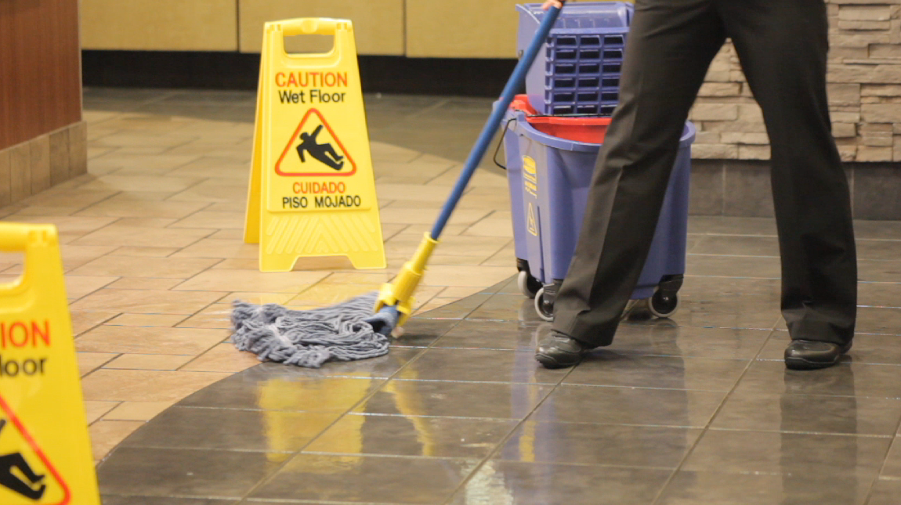
Final Word
Housekeepers are valuable members of the healthcare team.
They are exposed to many of the same risks as other healthcare workers – sometime at a higher risk.
Housekeepers need to be extra vigilant to keep themselves, their colleagues, patients and visitors safe.
Notes:
Final Word
Housekeepers are valuable members of the healthcare team.
They are exposed to many of the same risks as other healthcare workers. Sometimes they are at higher risk, cleaning up after clinical staff have finished what they were doing and rushed onto their next patient.
Housekeepers need to be extra vigilant to keep themselves, their colleagues, patients and visitors safe.

