Slide 1

Click anywhere to get started…

Slide 2

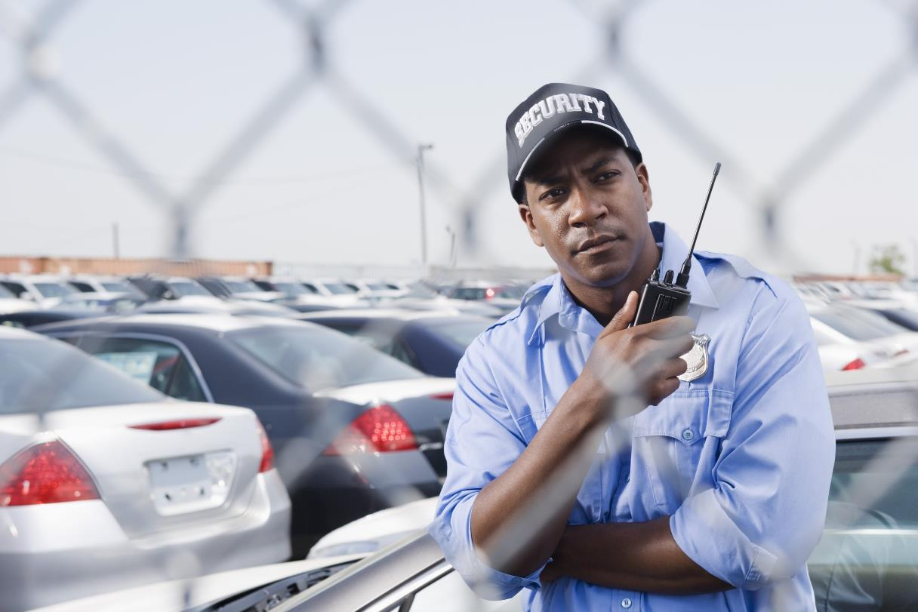

Parking Lot Security
Notes:
Parking Lot Security

Slide 3
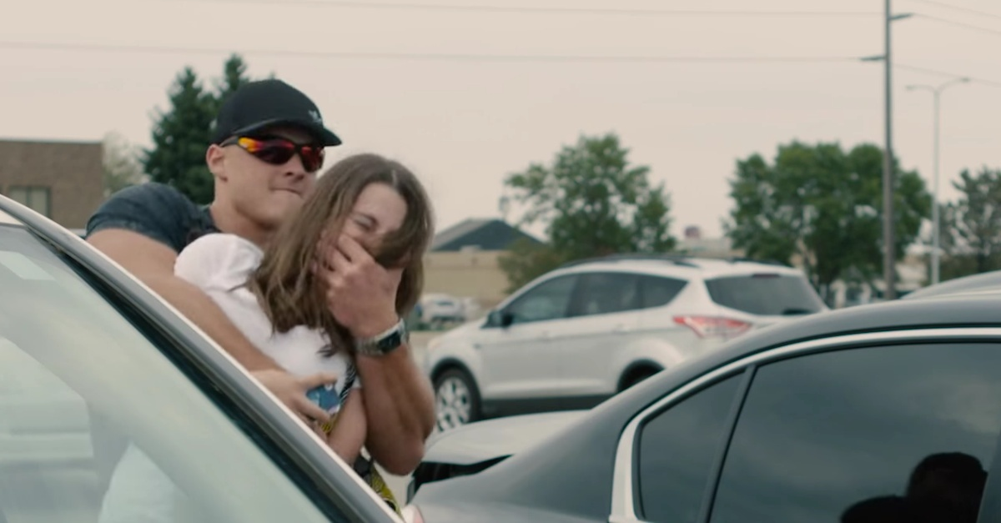
What’s at Stake?
When you are going to or leaving from a parking lot, garage, or other parking area how often do you:
Check over your shoulder to see who is behind or near you?
Pay attention to your surroundings instead of walking and looking at your phone or daydreaming?
Look in and around your vehicle for anything suspicious or out of the ordinary?
Notes:
What’s at Stake?
When going to or leaving from a parking lot, garage, or other parking area how often do you check over your shoulder to see who is behind or near you? Pay attention to your surroundings – really pay attention instead of walking and looking at your phone or daydreaming? Look in and around your vehicle for anything suspicious or out of the ordinary?

Slide 4
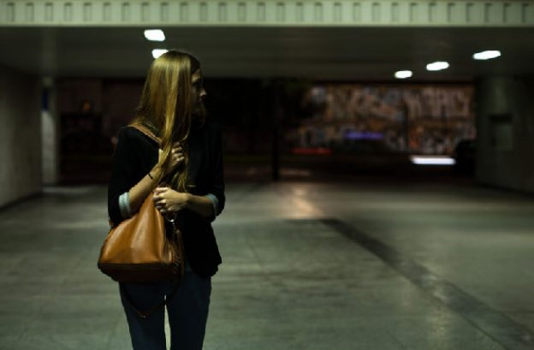
What’s the Danger?
Parking areas are danger zones.
You are vulnerable to theft, assault, and other violence.
Particularly at night and off-shift hours when there are few, if any, people around.
Notes:
What’s the Danger?
Parking areas are danger zones. You are vulnerable to theft, assault, and other violence when you travel from a workplace or shopping area to the relative safety of your vehicle. This is particularly true at night and off-shift hours when there are few, if any, people around.

Slide 5
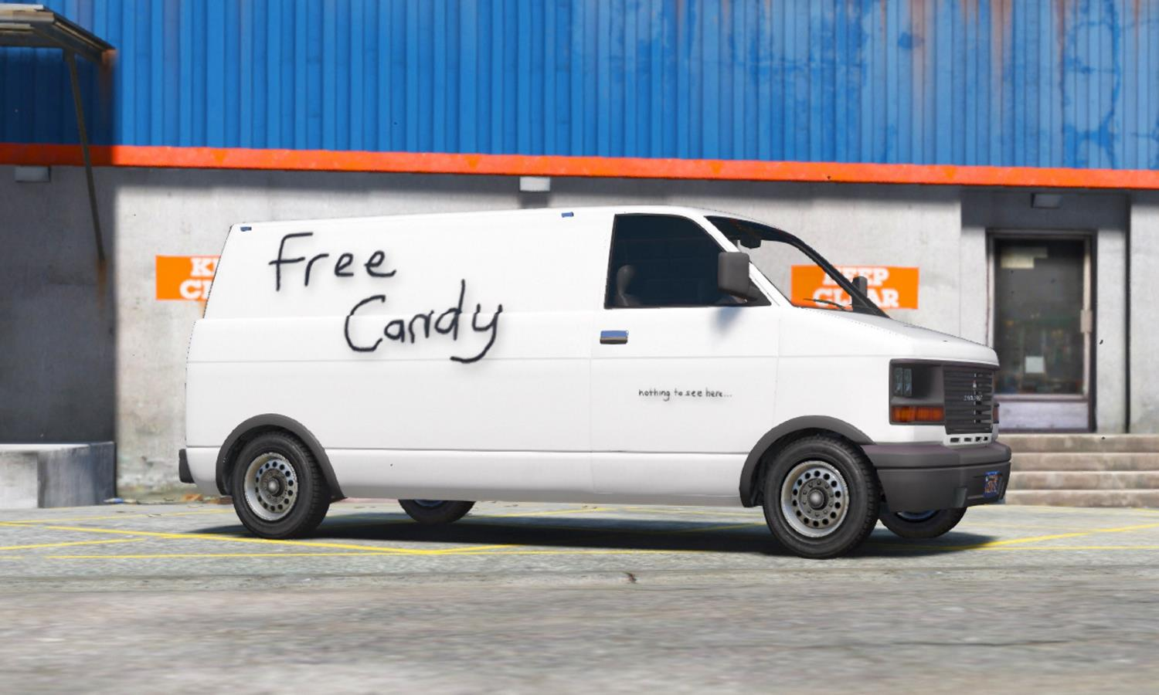
How to Protect Yourself
Park in well-lit areas - avoid parking next to vans or thick shrubbery.
Park near building entrances, rather than in isolated areas of parking lot or parking garage.
Use parking escort services or travel to and from your vehicle with co-workers.
Notes:
How to Protect Yourself
Here are 14 safe parking strategies you can follow.
Park in well-lit areas and avoid parking next to vans or thick shrubbery. Don’t walk near vans either. Within seconds the doors could slide open, someone could grab you, close the doors and take off.
Park near building entrances, rather than in isolated areas of the parking lot or parking garage. Try to choose a parking space that is visible from the building lobby or from the street.
Use parking escort services OR travel to and from your vehicle with co-workers.

Slide 6
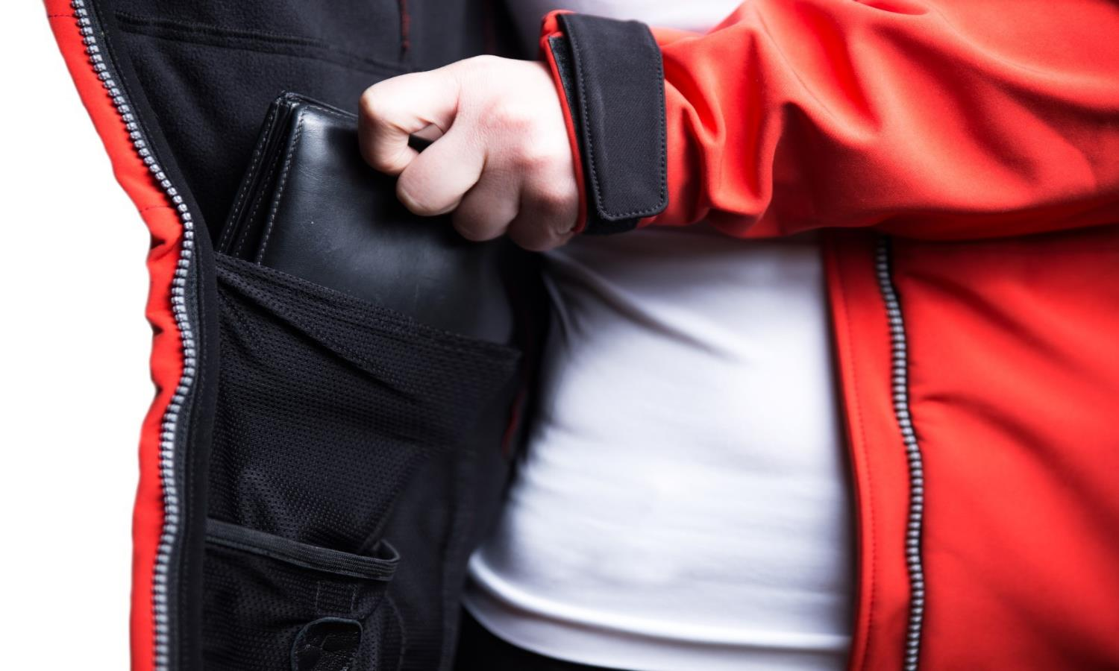
How to Protect Yourself
Find your vehicle key before going to the parking area. It can be used as a weapon.
Carry your wallet in an inside pocket. Hold your purse or briefcase securely - be prepared to use it as a weapon or let it go.
Look around and watch for loiterers, observe other vehicles, particularly those with someone inside. Stay clear of vehicles with darkly-tinted window which could conceal occupants.
Notes:
Find your vehicle key before going to the parking area, so you’re not searching for them when at your vehicle. The key can be used as a weapon if you are threatened.
To discourage thieves, carry your wallet in an inside pocket. Hold your purse or briefcase securely but be prepared to use it as a weapon or let it go rather than risk injury by defending it.
Look around before you head for your car, watch for loiterers and observe other vehicles, particularly vehicles with someone in them. Stay clear of vehicles with darkly-tinted window which could conceal occupants.

Slide 7
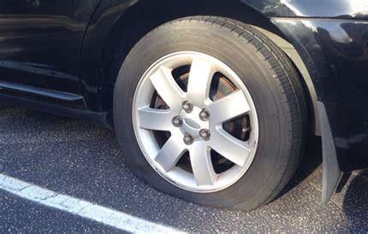
How to Protect Yourself
Look under and beside vehicle, and in backseat for people hiding.
In a two-door car, flip seats forward when you leave. If they’ve been moved, someone has been/might still be in your car. Leave the area and call for help.
Be suspicious if you return to your vehicle and find a flat tire.
Lock doors as soon as you enter vehicle – keep locked while driving and when parked.
Notes:
As you approach your automobile, look under and beside it for people hiding. Check in the back seat also.
If you have a two-door car, flip the seats forward when you leave the car. If you find upon return they have been moved back, someone has been in your car and might still be there. Leave the area and call the police or parking lot security staff.
Be suspicious if you return to your vehicle and find a flat tire. This could be an attempt to catch you off guard for an attack.
Lock the doors as soon as you enter your vehicle. Keep them locked when you are driving and when you leave it parked.

Slide 8
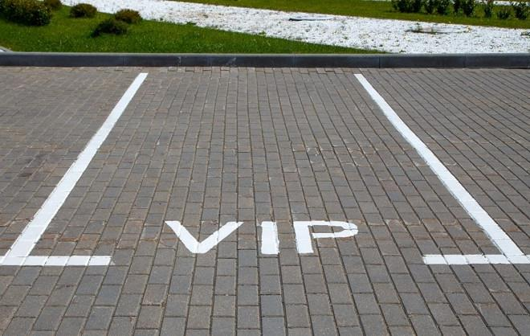
How to Protect Yourself
In parking garages, avoid stairwells. Consider walking down the auto ramp, if you can do so without risk of being struck by a vehicle.
If staying later than expected, move vehicle to less isolated spot.
Lock valuables in trunk and don't leave identifying documents in vehicle.
While a personal parking space is a great job perk, don't have your name on it. This information might make you a target.
Notes:
In parking garages, avoid isolated areas such as stairwells. You might consider walking down the auto ramp instead, if you can do so without risk of being struck by a vehicle.
If you are staying later than you expected, move your vehicle to a less isolated spot before it gets dark.
Lock valuables in the trunk and don't leave identifying documents such as insurance papers in the vehicle. Out of sight is safer.
While a personal parking space is a great job perk, don't have your name on it. This information might make you a target.

Slide 9
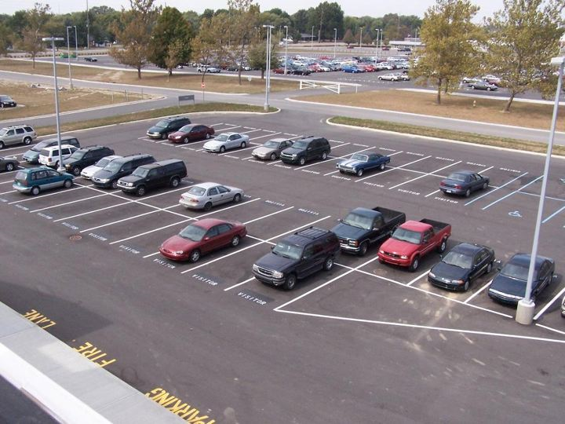
Final Word
Parking lots can make you an easy target for crime.
Stay safe by staying alert, observant, and ready to run or fight.
Notes:
Final Word
Parking lots can make you an easy target for crime. Stay safe by staying alert, observant, and ready to run or fight.

