Slide 1

Click anywhere to get started…

Slide 2

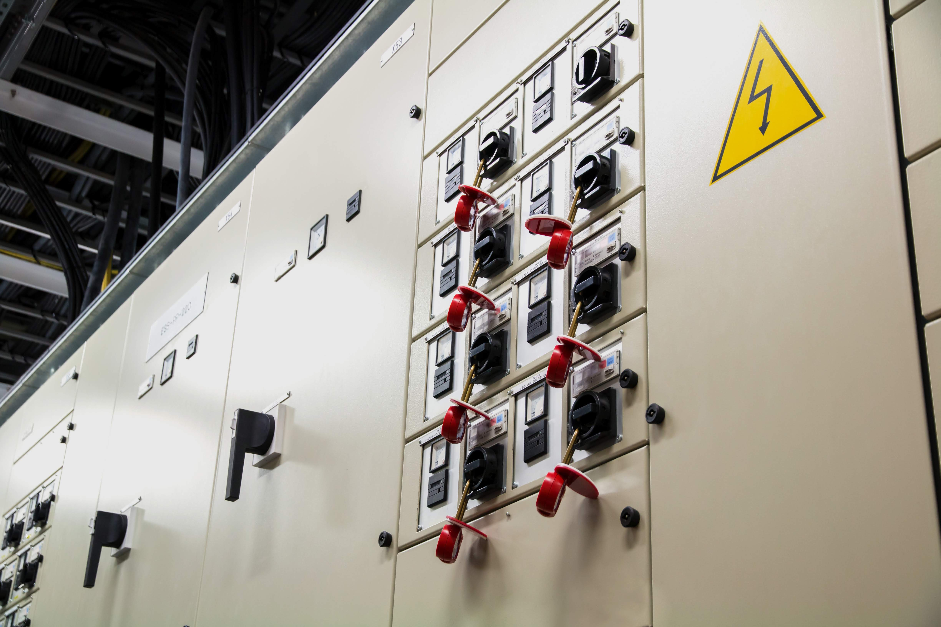

Lockout/Tagout – Even for Short Jobs
Notes:
Lockout/Tagout – Even for Short Jobs

Slide 3
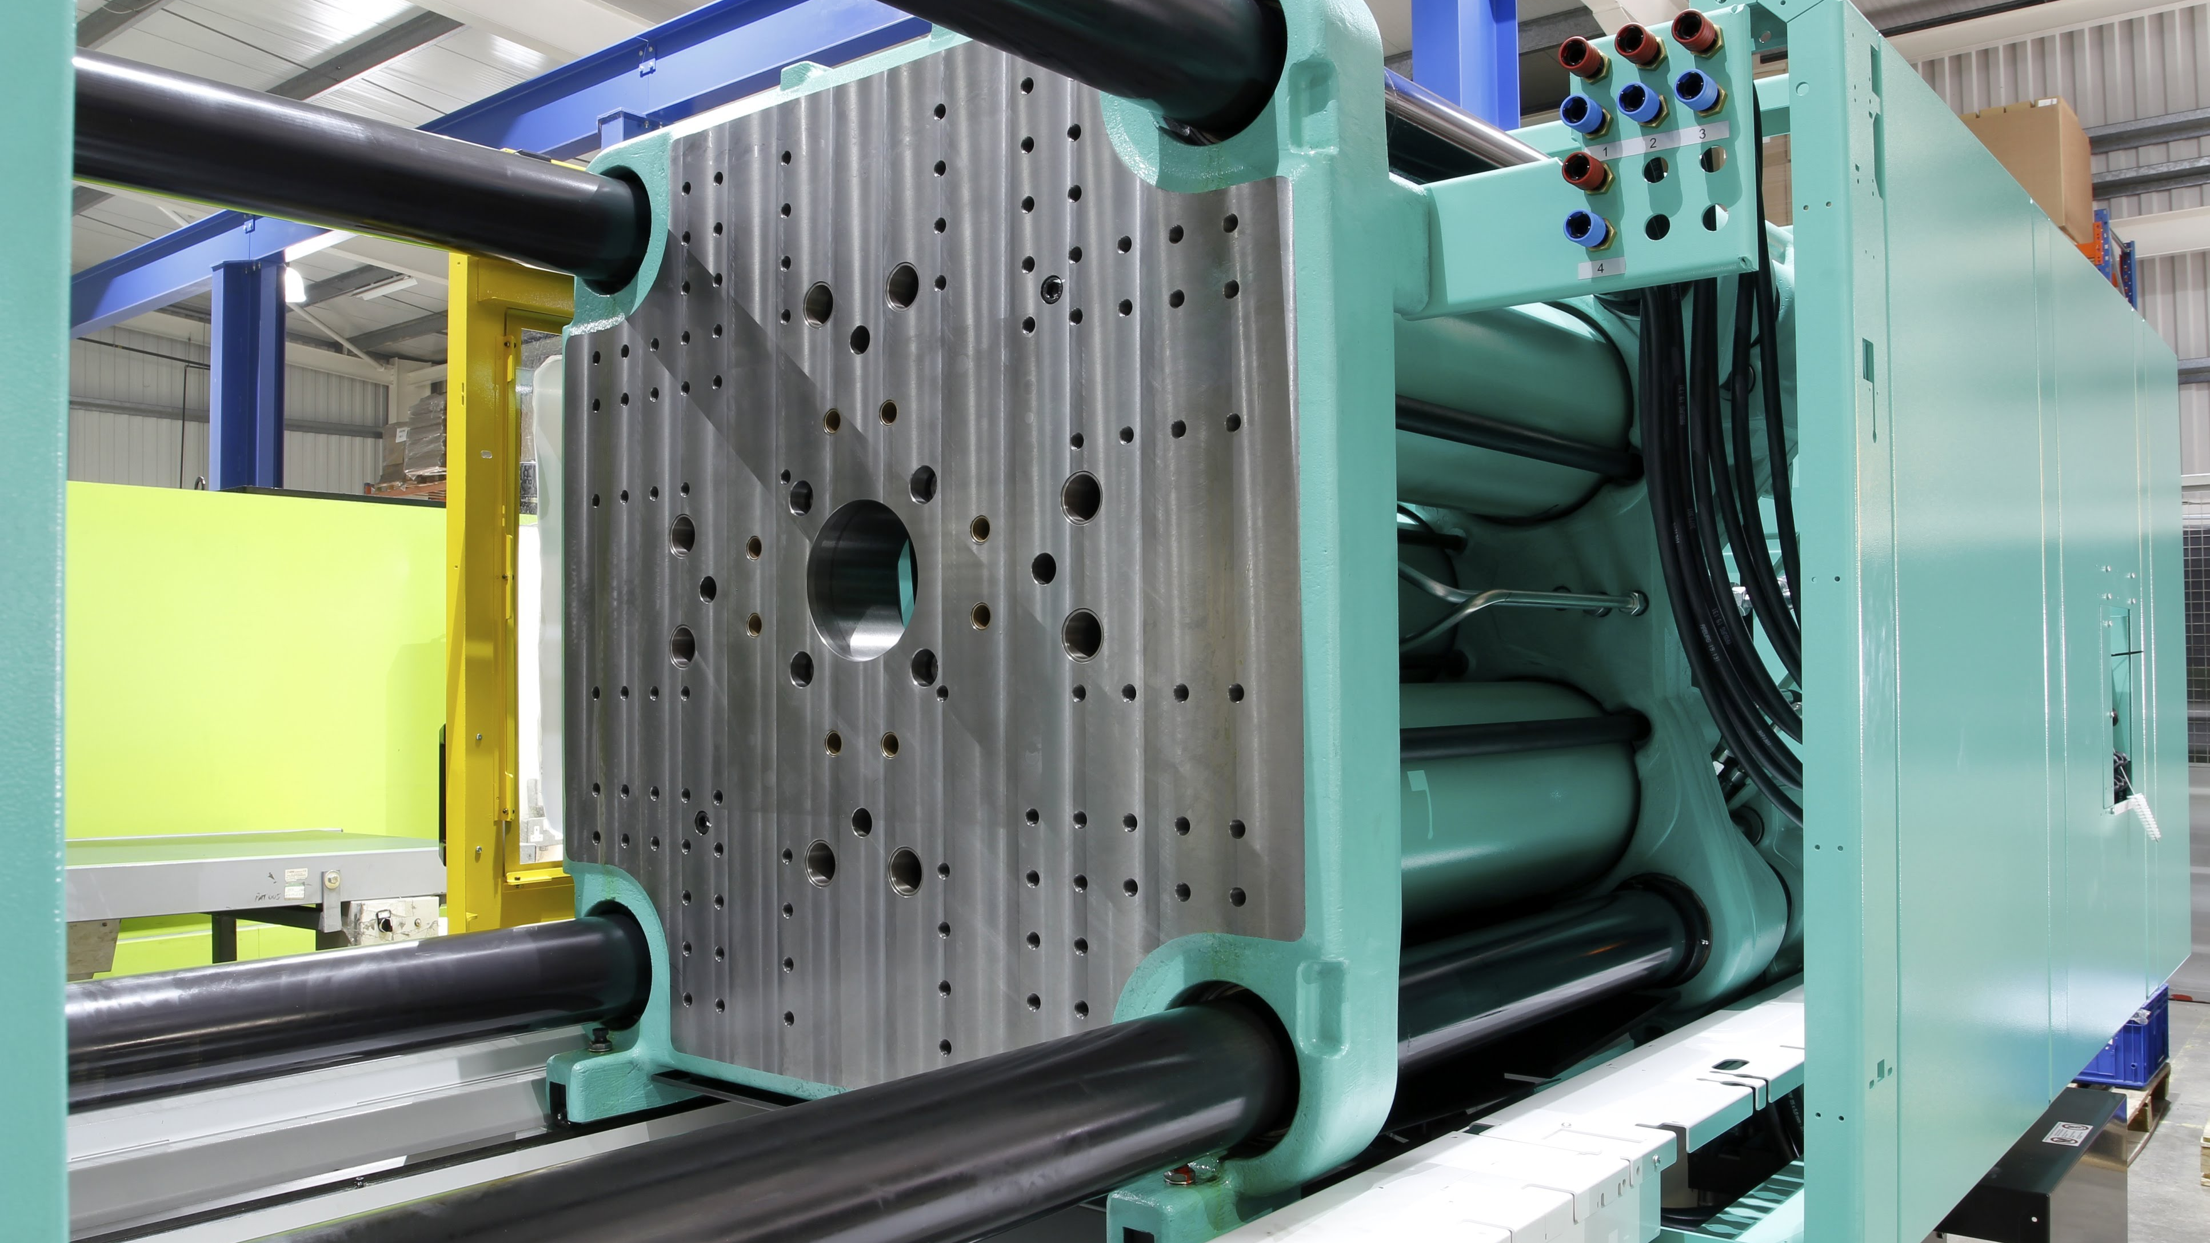
What’s at Stake?
It can be tempting to skip a lockout procedure just to make a quick adjustment on a machine.
This kind of thinking is a mistake. In fact, it can be a fatal mistake.
Many workers have been killed when they left a machine running or skipped the lockout just to do a quick clean-up or adjustment.
Notes:
What’s at Stake?
It can be tempting to skip a lockout procedure just to make a quick adjustment on a machine. This kind of thinking is a mistake. In fact, it can be a fatal mistake. Many workers have been killed when they left a machine running or skipped the lockout just to do a quick clean-up or adjustment.

Slide 4
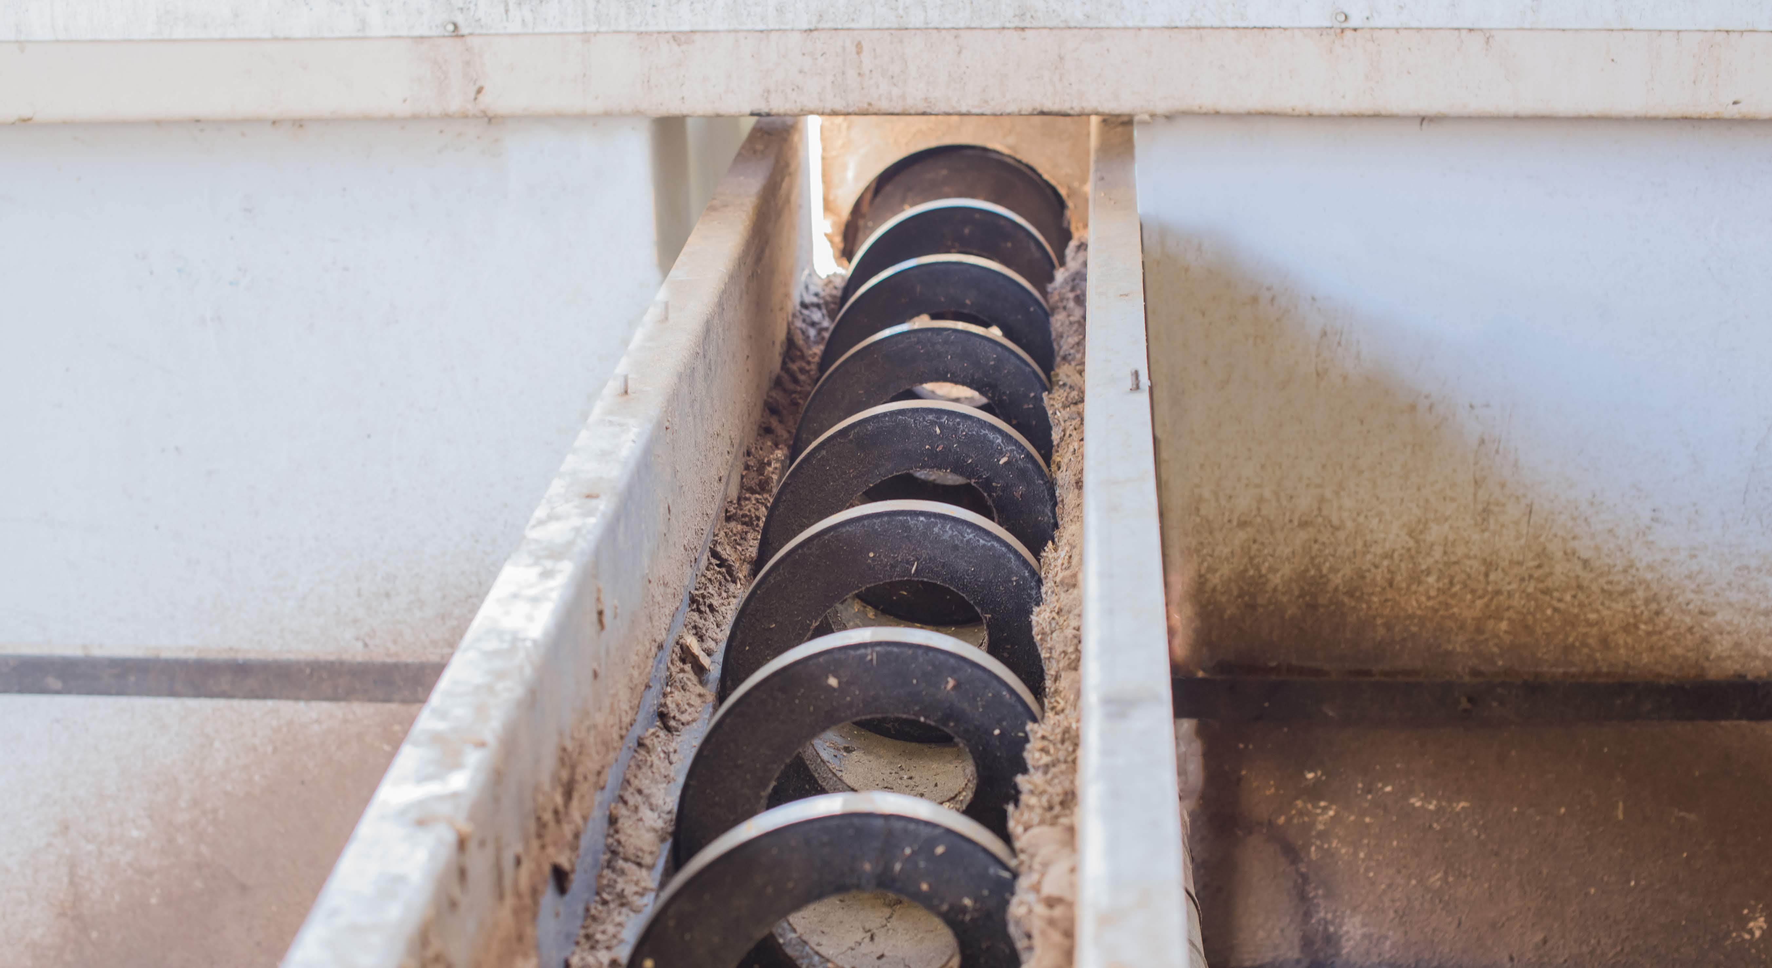
What’s the Danger?
While you’re doing repairs, you can’t assume your co-workers will see you or know that you’re there.
The result is they could turn on the equipment and you could be crushed, electrocuted or otherwise seriously injured.
Notes:
What’s the Danger?
When you adjust or repairs to a machine, you might have to reach inside the machine, or otherwise place yourself in the danger zone. While you’re doing these repairs, you can’t assume your co-workers will see you or know that you’re there. The result is they could turn on the equipment and you could be crushed, electrocuted or otherwise seriously injured. And if you’re working with equipment that is activated by electronic sensors or directed by computers, it can move unexpectedly when triggered by movement.

Slide 5
Deadly Example
A sawmill employee operating an automated stacker noticed a board out of place. He left his work station to fix and did not lock out the controls or energy sources.
He was in between the stack of lumber and a steel beam when the rollers began to move.
The operator was slammed into the steel beam and died of head and neck injuries.
Notes:
Example
A sawmill employee was operating an automated stacker when he noticed a board out of place on the top of the bundle of lumber. He left his work station and went to the stack to try to straighten the board. He did not lock out the controls or energy sources for the equipment before he attempted the adjustment. He put himself in a position between the stack of lumber and a steel beam. Then he accidentally tripped the electric eye, which was supposed to sense when the stack was complete and ready to move. Rollers began to move, advancing the stack. The operator was slammed into the steel beam. He died of head and neck injuries.

Slide 6
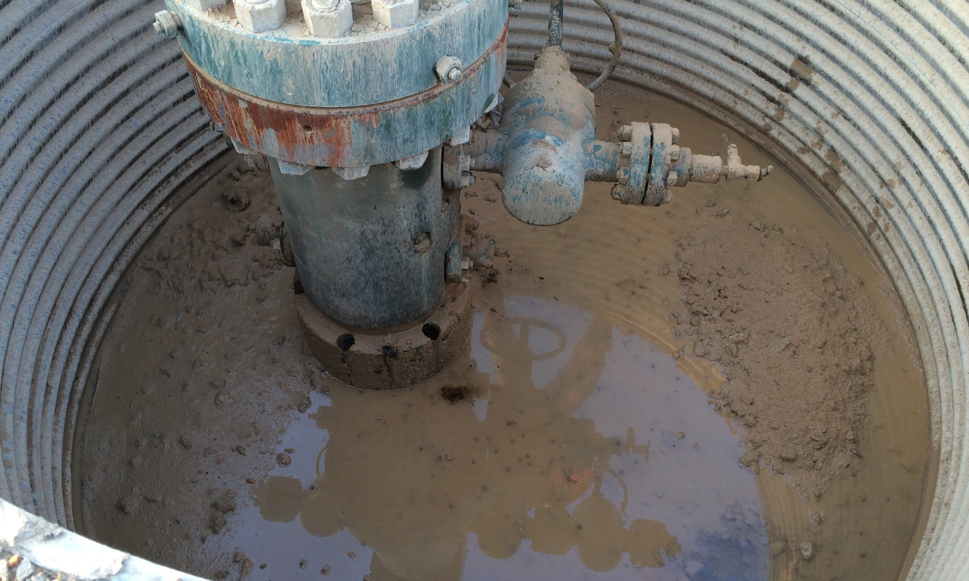
How to Protect Yourself
Lockout isolates the machine from energy sources - electrical, compressed air, hydraulic, fuel and others.
Lockouts prevent worker from being struck by materials moving through machines, pipes, or other conduits.
Notes:
How to Protect Yourself
Before anyone attempts to repair or adjust a machine, it must be shut down and isolated from energy sources so it cannot accidentally start up.
That’s where lockout procedures come in. A lockout isolates the machine from energy sources which could cause it to operate or to move. These sources include electrical, compressed air, hydraulic, fuel and others. Lockouts are also used to prevent the worker from being struck by materials moving through the machine or even through pipes or other conduits.

Slide 7
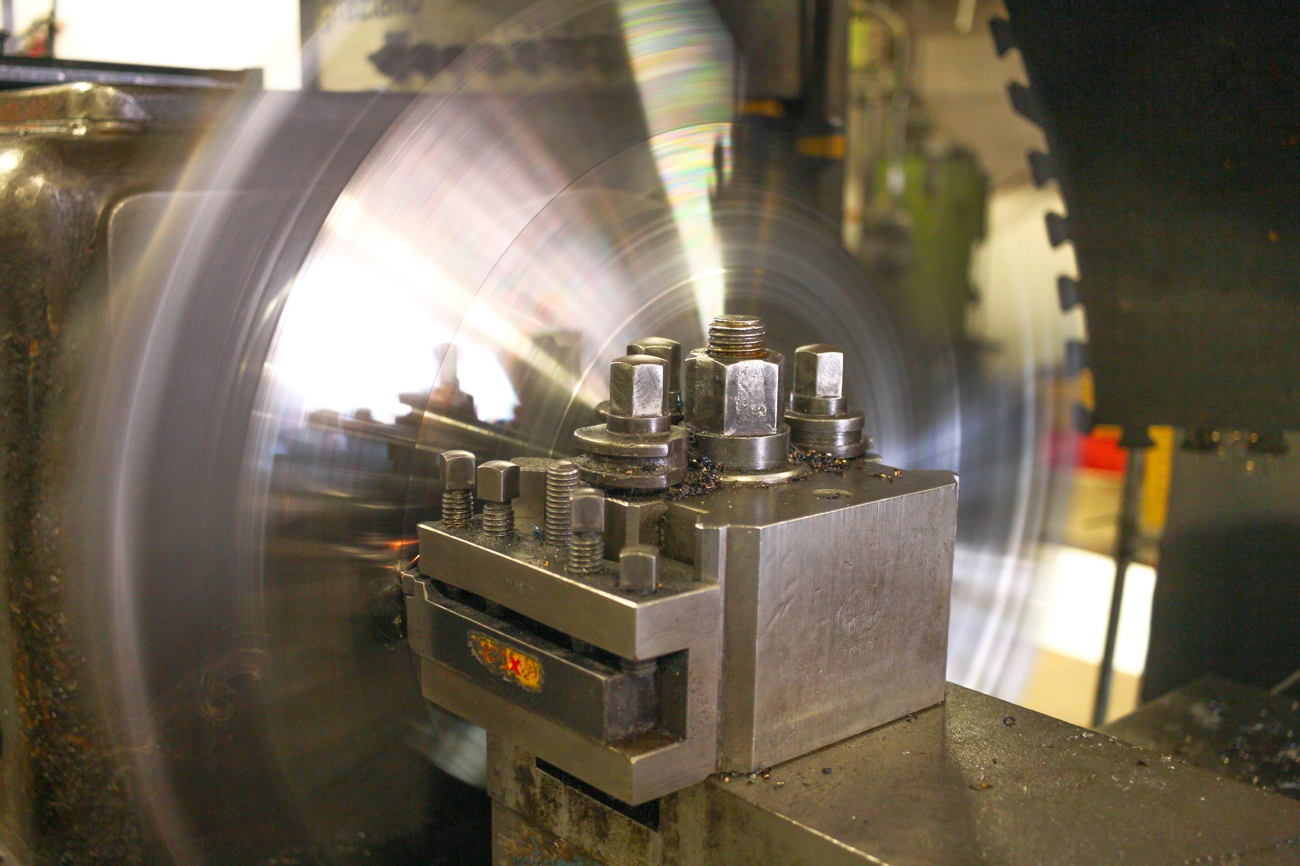
How to Protect Yourself
Identify all sources of energy and controls
Notify all affected workers
Shut down machinery
Isolate the machinery
Notes:
How to Protect Yourself
Become thoroughly acquainted with your company’s lockout procedures. Here are the steps to a typical lockout:
Identify all the sources of energy and how to control these sources.
Notify all affected co-workers of the planned lockout.
Shut down the machinery using the ordinary method such as throwing a switch or hitting a stop button.
Isolate the machinery from all sources of energy by turning off main power switches, breakers and other controls.

Slide 8
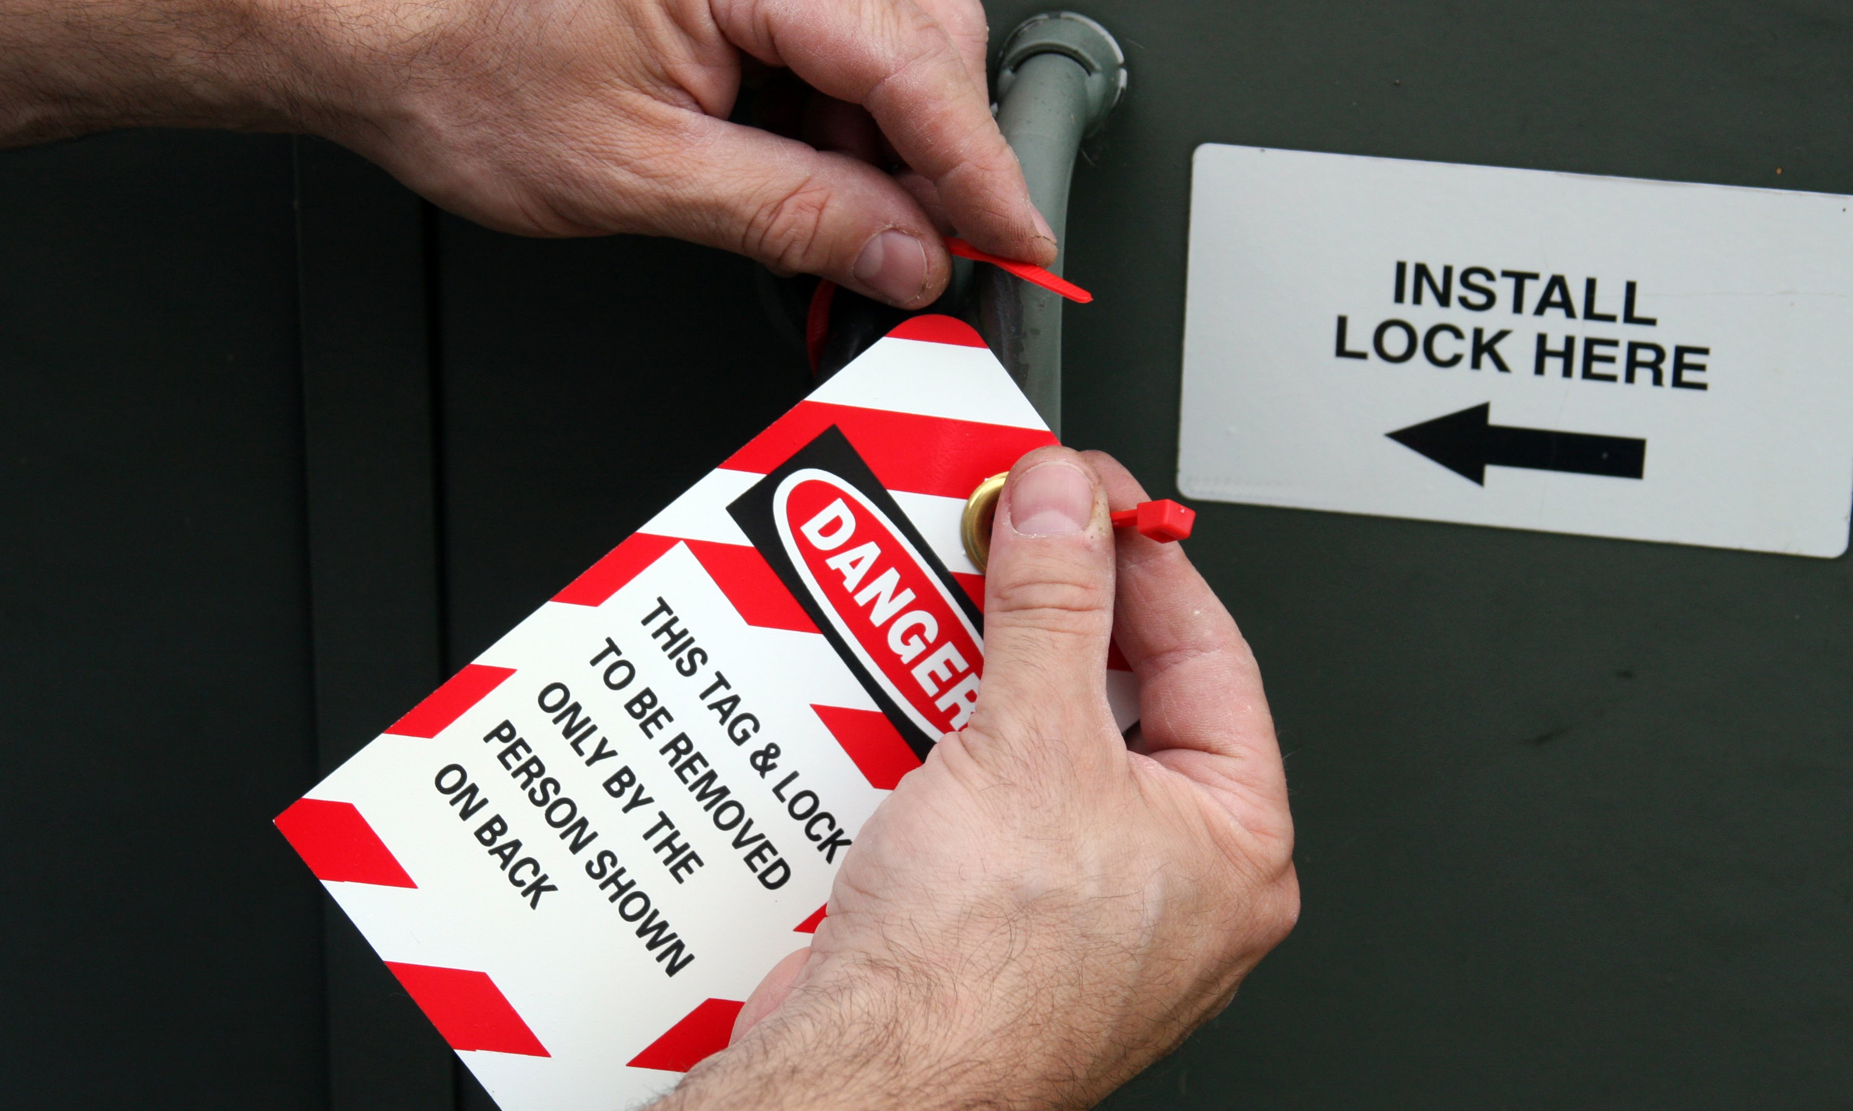
How to Protect Yourself
Place lock/tag on each switch and control
Release all potentially hazardous energy,
Test equipment - verify all energy sources are disconnected
Remove locks and tags and return machine to service
Notes:
How to Protect Yourself
Place a lock on each of these switches and controls. Each lock is accompanied by a tag indicating who is doing the lockout.
Release all potentially hazardous energy, including that in springs, rotating wheels, air pressure, raised loads, hydraulic pressure and other sources.
Test the equipment to make sure all energy sources are disconnected. The switches are returned to the “off” position after testing.
After the repairs or adjustments are done, remove the locks and tags and return the machine to service.

Slide 9
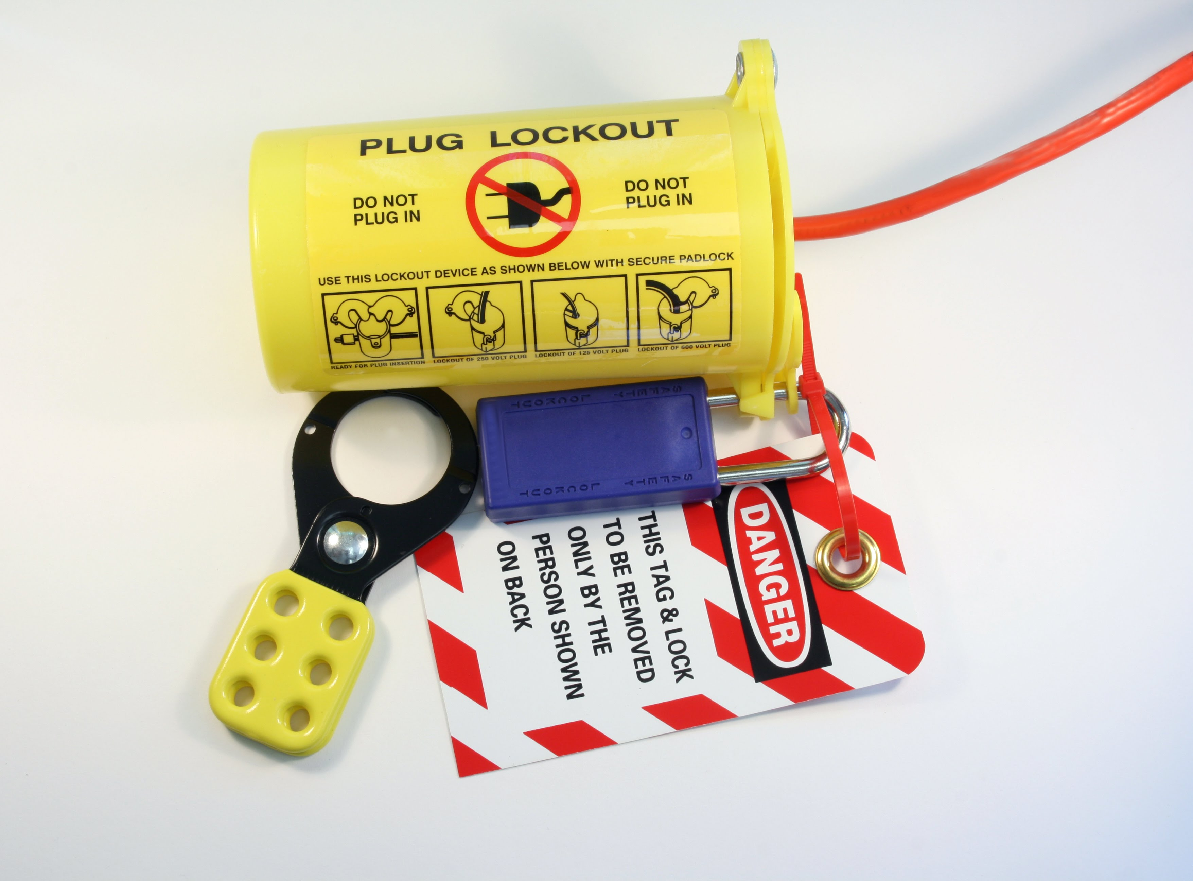
How to Protect Yourself
Even if lockout isn’t part of your job function, you’re still responsible for working safely around machinery.
Know how your company’s lockout system works and stay away from a locked and tagged machine.
Notes:
How to Protect Yourself
Even if lockout isn’t part of your job function, you’re still responsible for working safely around machinery. Know how your company’s lockout system works and stay away from a locked and tagged machine.

Slide 10
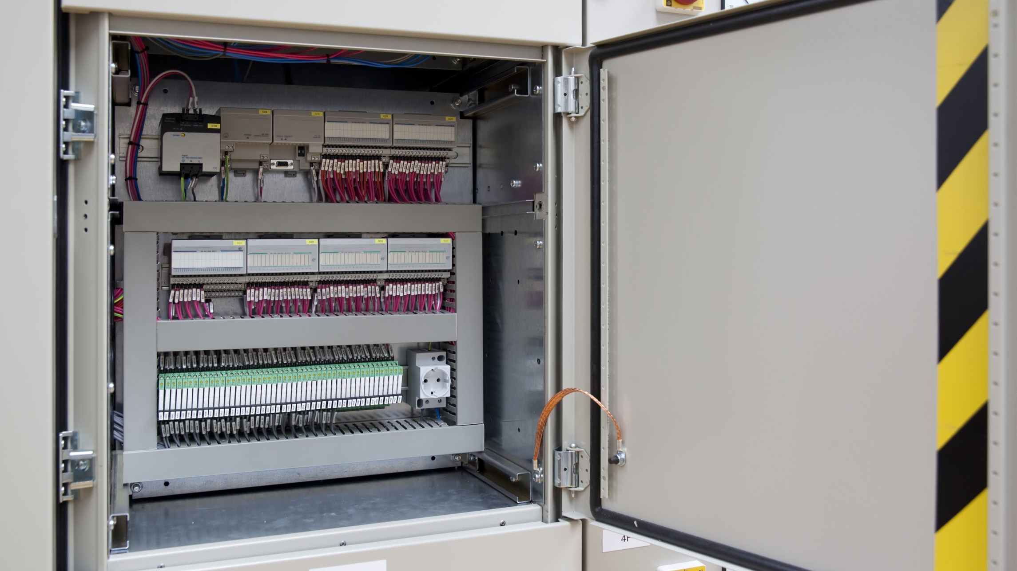
Final Word
A lockout is insurance against being struck by moving equipment while you are doing repairs or adjustments. Use it every time — even for quick jobs.
Notes:
Final Word
A lockout is insurance against being struck by moving equipment while you are doing repairs or adjustments. Use it every time — even for quick jobs.

